Slide 1

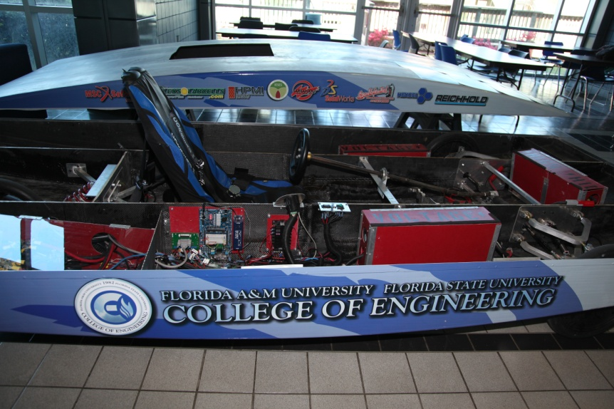

Solar Car Phase II Design
Final Presentation
Electrical Engineers
Zachary Prisland
James Barge
Shishir Rajbhandari
Mechanical Engineers
Keith Dalick
Adrian Cires
Emiliano Pantner
Industrial Engineers
Nelson German
Rajat Deep Pradhan
Amanda Roberts

Slide 2
Body

Slide 3
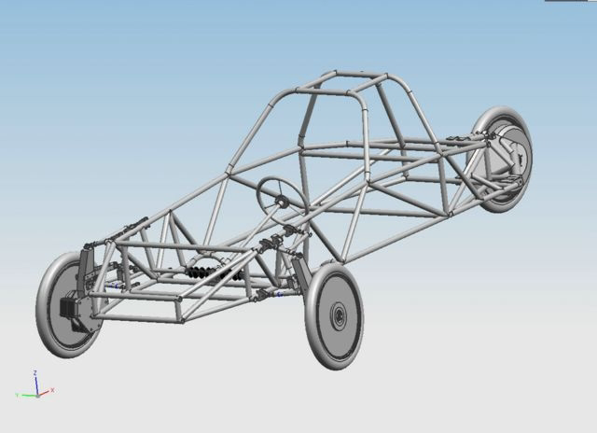
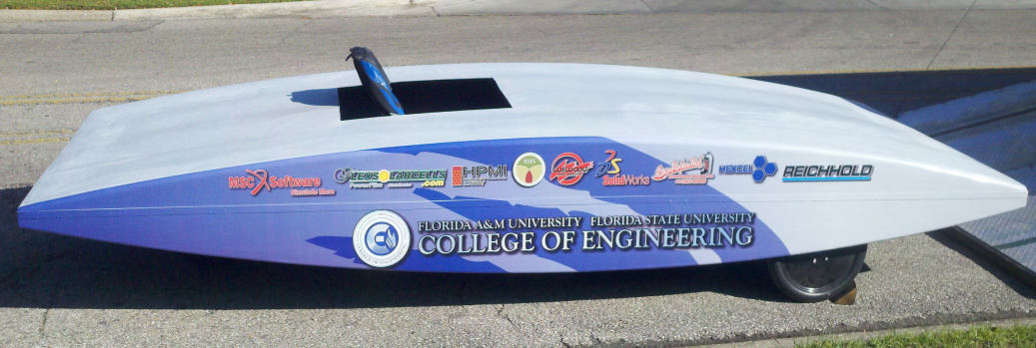
Design of Frame
Phase I Design
Steel chassis frame with three wheels
~900lbs
Phase II Design
Monocoque Unibody
509 lbs
Made from Carbon Fiber
Aerodynamic

Slide 4
Tensile Testing 12K Carbon
Sample | Ultimate Testing (MPa) | Tensile Modulus (GPa) | Elongation (%)
1 | 149.40 | 5.51 | 5.18
2 | 154.22 | 5.30 | 4.39
3 | 124.09 | 5.66 | 3.337
4 | 120.46 | 5.17 | 5.81

Slide 5
Carbon Fiber Body
Vacuum Bagging Infusion Process

Slide 6
Braking System

Slide 7

Braking System
Hydraulic disc brake system
Sponsored by Wilwood Engineering
Disc brakes installed on front two wheels

Slide 8
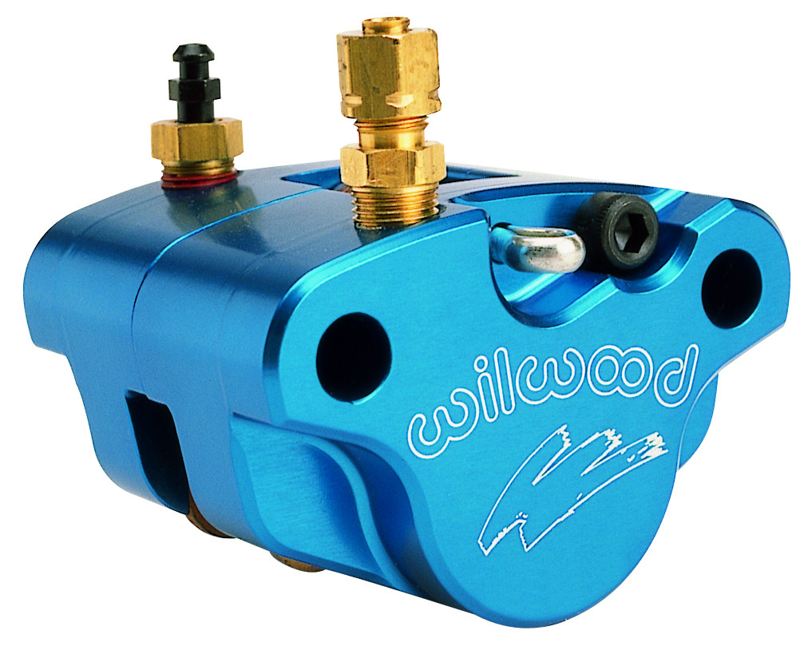
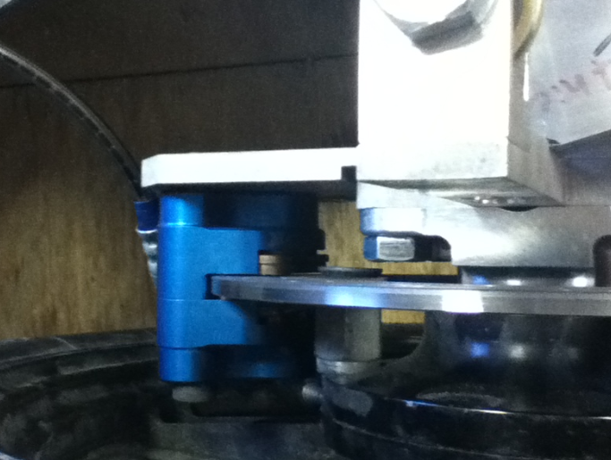
Brake Caliper
Go kart brake caliper
Suitable for solar car’s lightweight
Features:
  Self retracting and adjusting piston
  Steel piston for reduced heat transfer

Slide 9

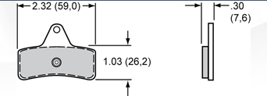
Brake Pads
Sintered metallic brake pads
High friction brake pads
Little change of friction due to high temperatures

Slide 10
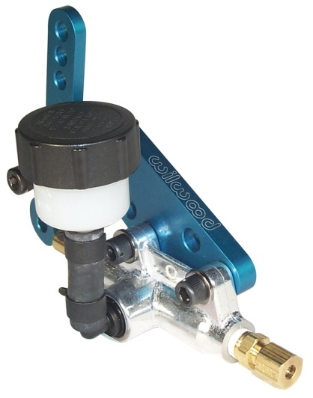
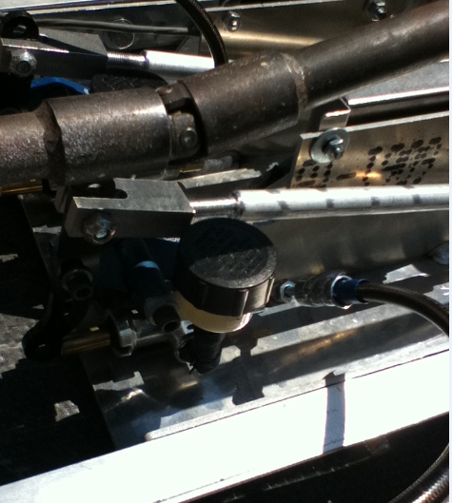
Master Cylinder
Go-Kart master cylinder
Specifically designed for use with selected caliper
Features
  Adjustable lever ratio
  Lightweight aluminum cylinder

Slide 11
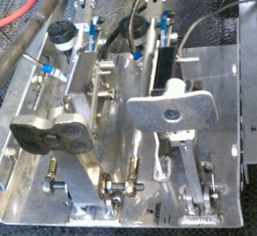
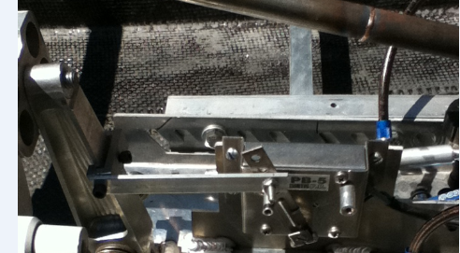
Pedal Cluster
New pedal cluster designed and fabricated
Coupling links to activate regenerative brake

Slide 12
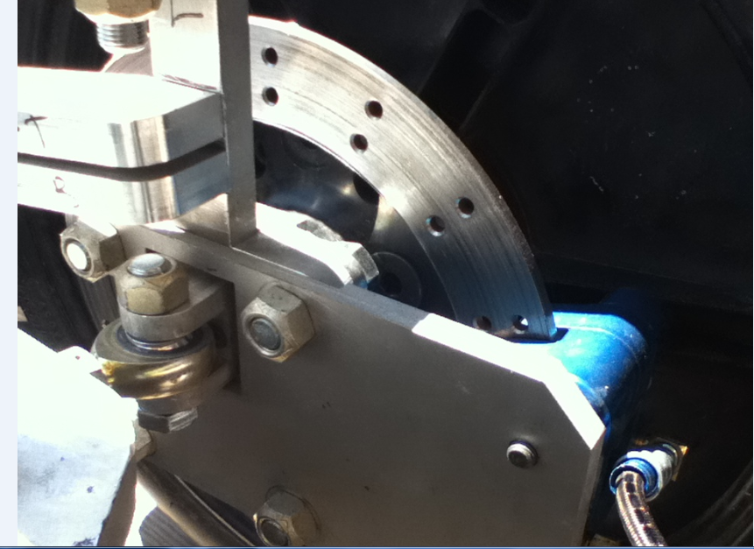
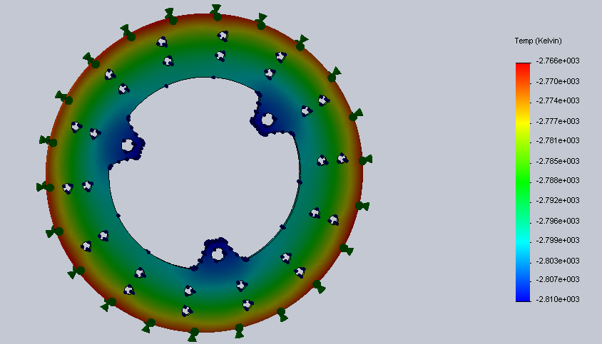
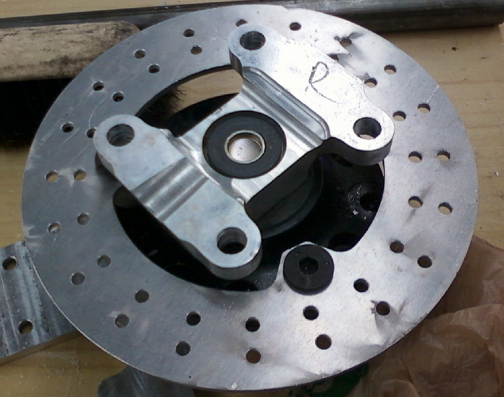
Brake Rotor
Brake rotor fabricated in machine shop
Static and thermal analysis using Solidworks simulation software

Slide 13

Brake Performance
Calculated vehicle deceleration:
Deceleration of 25.4 m/s^2
Stopping distance at 30 mph:
  12.4 ft
Stopping distance at 50 mph:
  32.2 ft

Slide 14
Steering

Slide 15
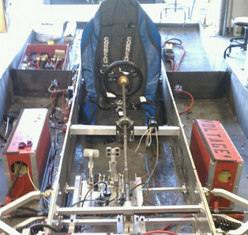
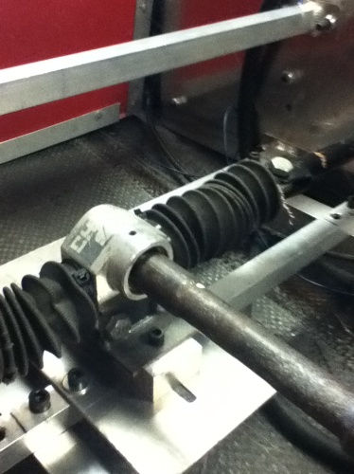
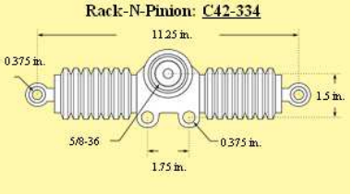
Steering
Steering components salvaged from last year’s car
6.1:1 gear ratio

Slide 16
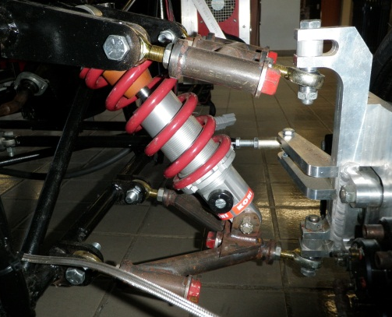
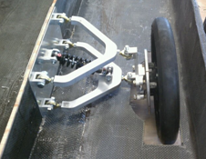
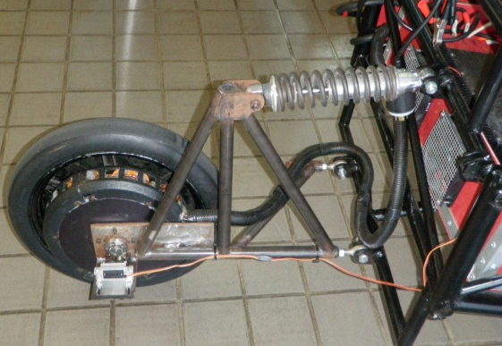
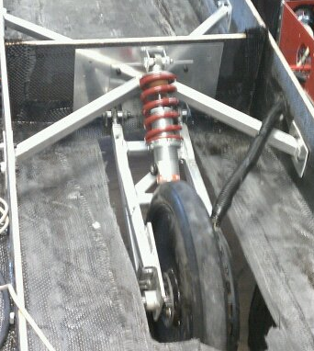
Suspension
Phase I
Phase II

Slide 17
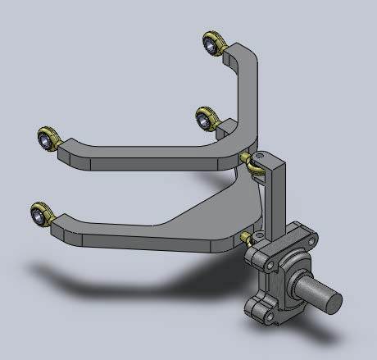
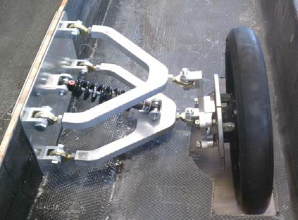
Front Suspension

Slide 18
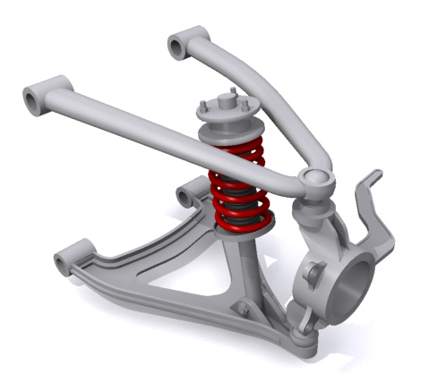
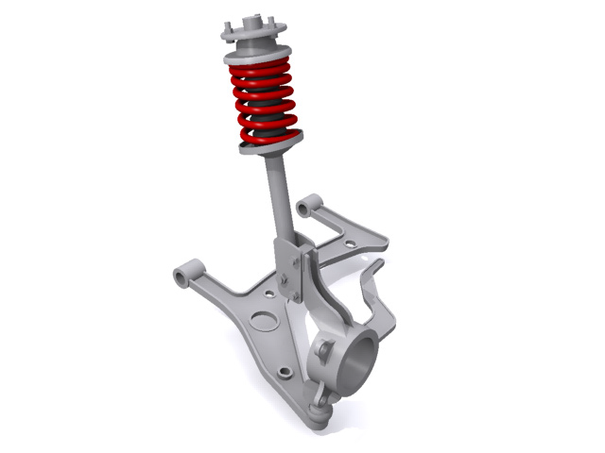
Options
MacPherson Strut
Double Wishbone
Strut-type shock
Average handling
Variation in camber angle
High overall height
More control over camber angle
Minimize body roll and sway
More consistent steering feel
Maintains wheel perpendicular to road surface

Slide 19
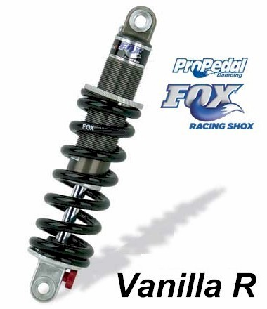
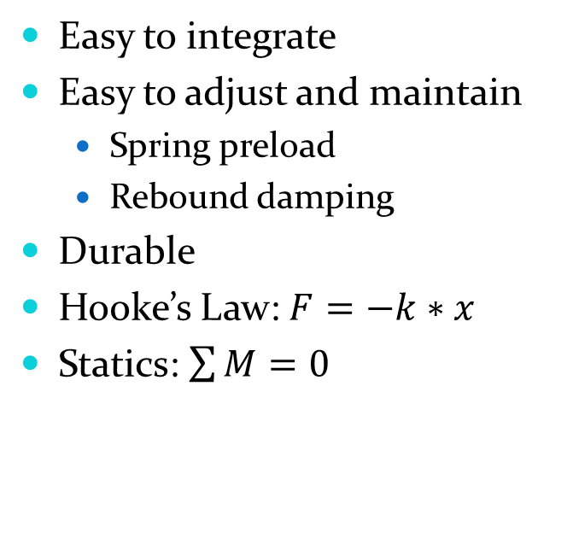
Shock
Coil Over Shock
Fox Racing Shox Vanilla R 05
Easy to integrate
Easy to adjust and maintain
  Spring preload
  Rebound damping
Durable
Hooke’s Law: $F=−k∗x$
Statics: $\sum{M}=0$
7.875 X 500 X 2.30
0.85 lbs

Slide 20
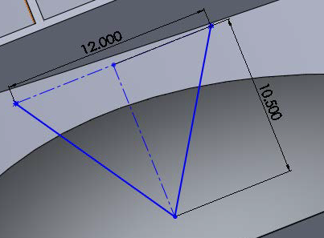
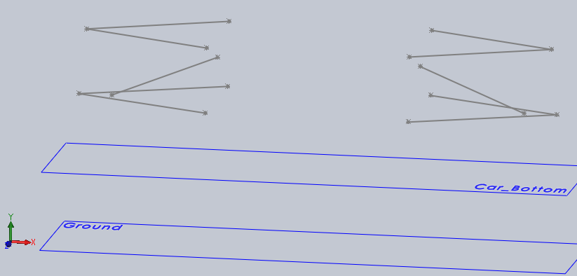
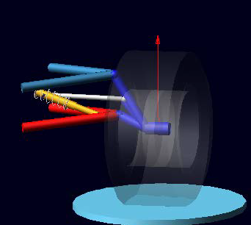
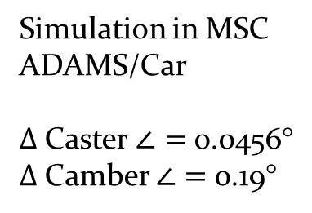
Design Process
Control arm sketch
Front suspension sketch with hardpoint locations
Simulation in MSC ADAMS/Car
$Δ$Caster $∠=$0.0456°
$Δ$Camber $∠=$0.19°

Slide 21
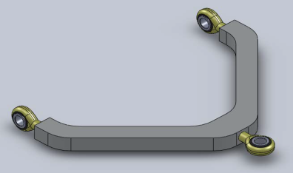
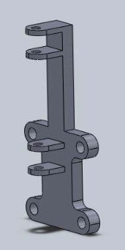
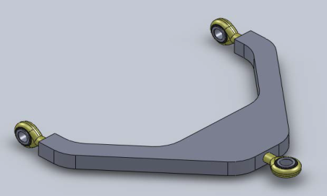
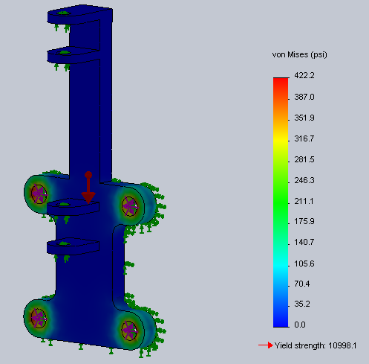
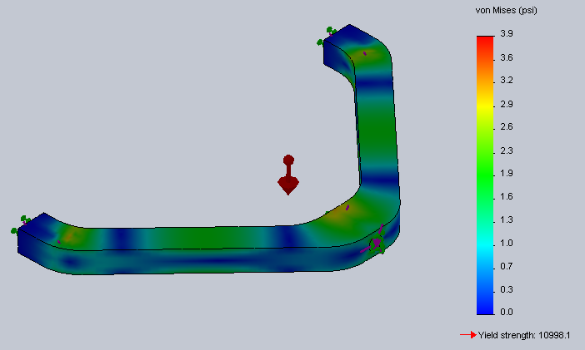
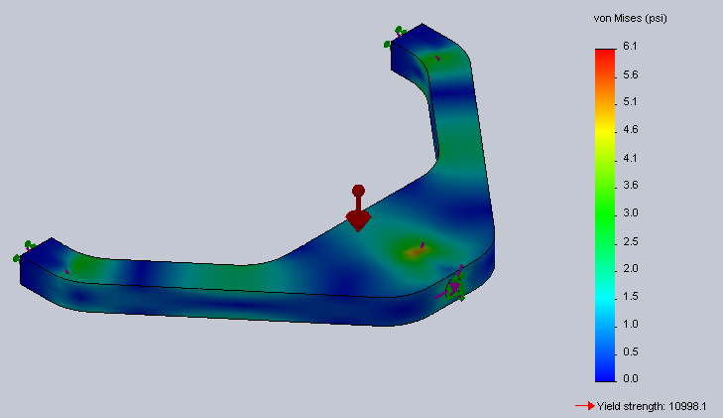
Design Process
Design 3D models of upright, upper control arm, and lower control arm
FEA on upright, upper control arm, and lower control arm
Final Product

Slide 22

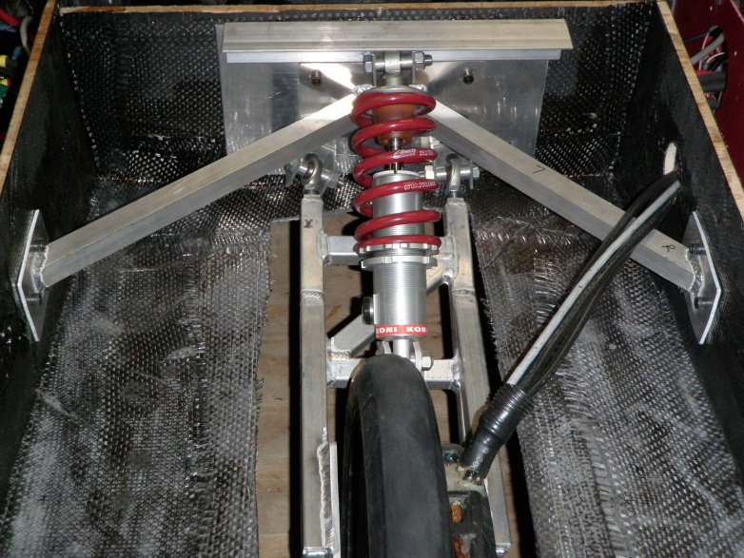
Rear Suspension

Slide 23
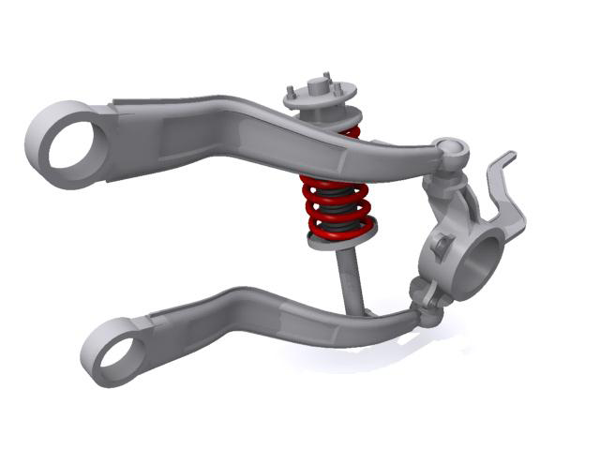
Single Trailing Arm
Allows the rear to swing up and down
No side-to-side scrubbing
Only allows the wheel to move up and down

Slide 24

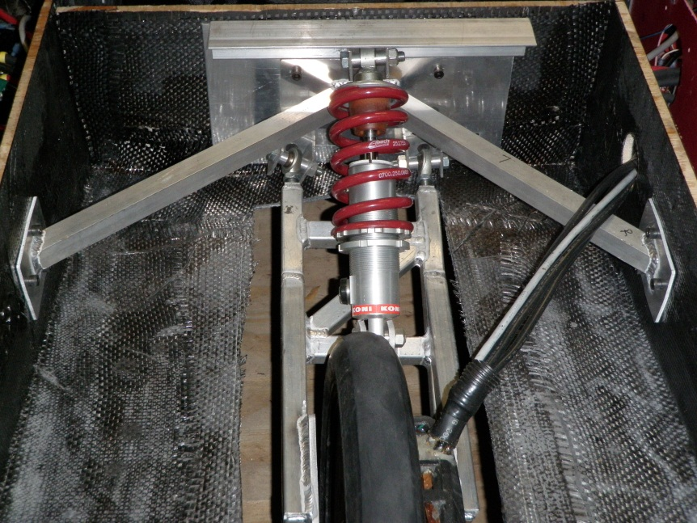
Phase I to Current Design
Similar design to Phase I
  Bulky
  Supported on one side of wheel
New design
  More compact
  Supports the single rear wheel with motor on both sides
  Welded square aluminum tubing

Slide 25
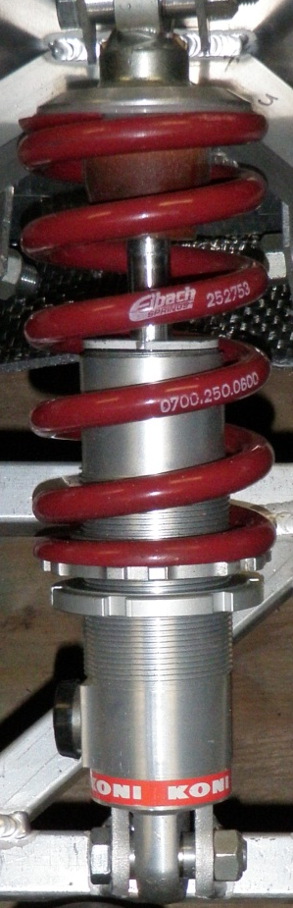
Shock
Coil Over Shock
Koni 8212-1408
Easy to integrate
Easy to adjust and maintain
  Spring preload
  Rebound damping
Durable
From Phase I
600 lb/in

Slide 26
Power Generation System

Slide 27
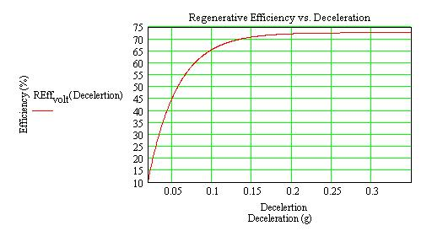
Regenerative Braking
Designed to collect as much kinetic energy as possible
31.3%, estimated efficiency over time for hybrid cars

Slide 28
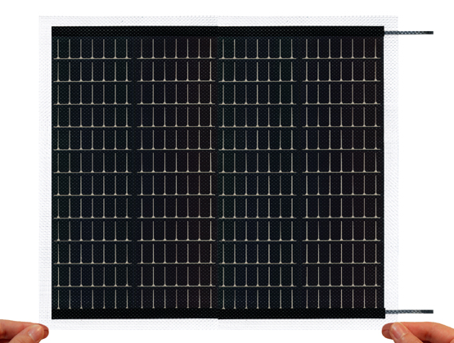
PowerFilm PT15-300 Solar Panel
Parameter | Data Sheet | Observed
Voltage (OC) | 19.0 V | 20.0 V
Current (SC) | 240 mA | 262 mA
Loaded Voltage | 15.4 V
Loaded Current | 200 mA
Ideal Power | 4.56 W | 5.25 W
Loaded Power | 3.08 W
Efficiency | 7.88 % | 9.07 %
Thermal Efficiency | -0.2 %/⁰C (over 25 ⁰C)
Panel Size | 9.5” x 11.8”
Weight | 3.3 oz

Slide 29
Full Array in Operation
Parameter | Value
Series Voltage | ~100 V
Parallel Current | ~4.19 A
Array Power | 420 W
Losses to heat | 21 W
Losses to angling | 126 W
Usable Power | 281 W
ASC designates 6 m²
82 possible panels
5 panels per series
16 parallel sets
Operating temperature ~50 ⁰C
28% power loss due to lack of perpendicular facing

Slide 30
MPPT
DC : DC Converter
Array Voltage (V) | 80 V
Array Current (A) | 1.25 A
Nominal Battery Voltage (V) | 96 V
DC Link Voltage (V) | 126 V
Duty Cycle (%) | 36.5 %
Frequency (kHz) | 40 kHz
Inductor (mH) | 7.3 mH
Capacitor (uF) | 221 uF
IGBT with anti-parallel diode | Switch
Non – Linear | Control Required

Slide 31
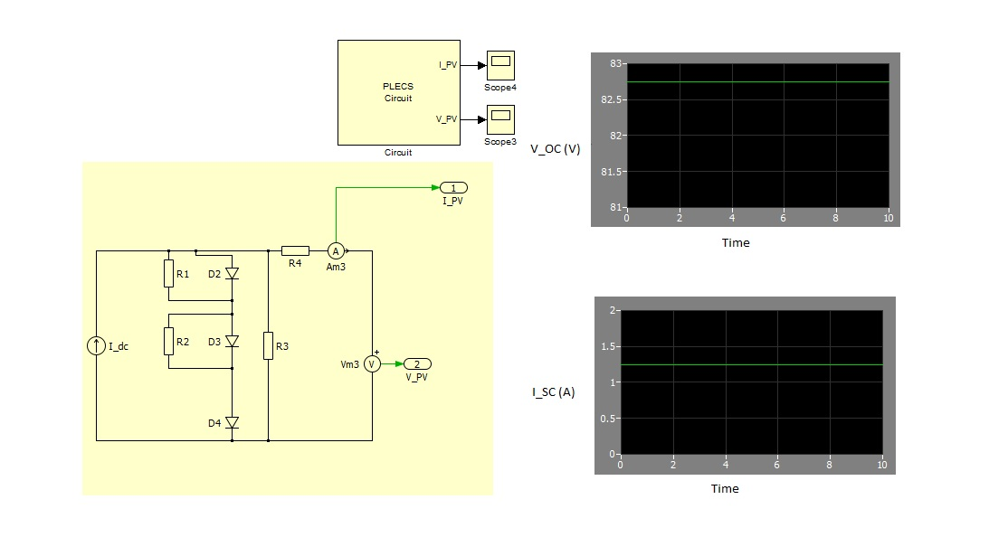
Solar Array Model

Slide 32
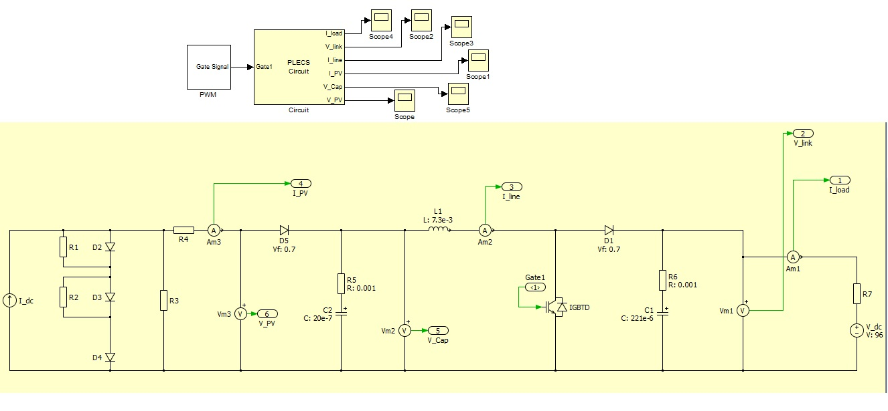
Solar Array – Converter – Battery

Slide 33
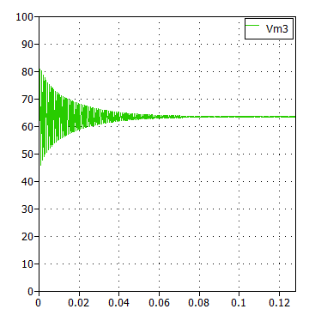
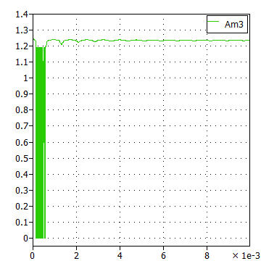
Simulation Results
V_PV (V)
I_PV (A)

Slide 34
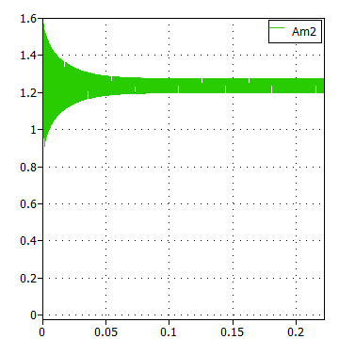
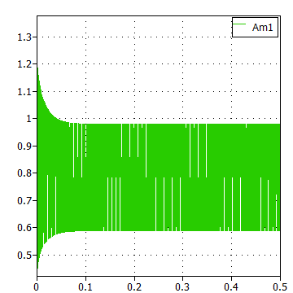
Simulation Results
I_Line (A)
I_Load (A)

Slide 35
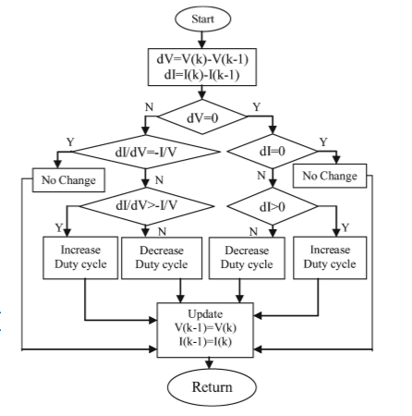
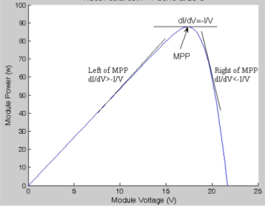
MPPT ALGORITHM
Incremental Conductance Algo.
Maximum Power Point Curve

Slide 36

MPPT BLOCK DIAGRAM

Slide 37
Control System

Slide 38

Circuit Diagram

Slide 39


Implementation

Slide 40
Thundersky LiFePO₄ Batteries
Protection Type | Restraining Value
Over Voltage | 4.25 V
Under Voltage | 2.5 V
Over Current | 120 A
Over Temperature | 75 °C
30 battery cells in series
96 V nominal operating voltage
3840 Wh of energy storage
Cell module connected to each battery
Battery Management System (BMS)

Slide 41

New Dashboard
From 8 switches down to 3 switches
Eliminated superfluous display elements
Overall simpler driving

Slide 42
Safety Equipment
Utilized proper wire gauging based on AWG table
Added 3 normally open relays
Added 10 more fuses to the system
Used quick disconnects between all components

Slide 43
Management System

Slide 44

State of Charge
Dashboard display
Battery fuel gauge
Shunt line current measurements
Pre-scaler for potential measurement
Ring terminal for battery temperature

Slide 45
Force Calculations
Assumptions:
.004 Tire Friction Coefficient (Dry Pavement)
.07 Air Drag Coefficient
1.164 kg/m³ Air Density (86 ⁰F)
13.41 m/s (30 mph)
  Calculations:
  Weight of Car 230 kg
  Normal Force 2256 N
  Reference Area .9365 m
  Rolling Frictional Force 9.024 N
  Air Drag Force 6.861 N
  Total opposing forces 15.885 N

Slide 46
Power Consumption
  213 W needed to overcome opposing forces at 30 mph
  30 W for 3 relays
  281 W generated by solar panels
  38 W net gain during daylight hours
  Permanent daylight operation
  628 W needed to overcome opposing forces at 50 mph
  377 W net loss during daylight hours
10.19 hours of operation
500 mile range

Slide 47
Budget & Schedule

Slide 48









Budget
System | Cost
Body | $8,820
Suspension | $622
Braking | $944
Power Generation | $4,734
Control System | $674
Management System | $938
Grand Total | $16,732
Donations | $12,031
Net Total | $4701
Budget given by University: $5,000
Donations Received: $12,031

Slide 49
Major Milestones
System level design review November 15, 2010
(November 15, 2010)
Assemble lower body December 16, 2010 (February 2, 2011)
Assemble upper body January 21, 2011
(March 3, 2011)
Detailed design review and test plan January 27, 2011
(January 27, 2011)
Configure lower body February 21, 2011
(March 19, 2011)
Install solar arrays February 23, 2011
(TBD)
Total body configuration March 15, 2011
(March 30, 2011)
Final testing March 29, 2011
(April 1, 2011)

Slide 50

Questions?

Slide 51
Equations

Slide 52
Websites Referenced
http://www.wheelsofitaly.com/wiki/index.php/Regenerative_brake
http://en.wikipedia.org/wiki/Rolling_resistance
http://hpwizard.com/tire-friction-coefficient.html

